Slide 1

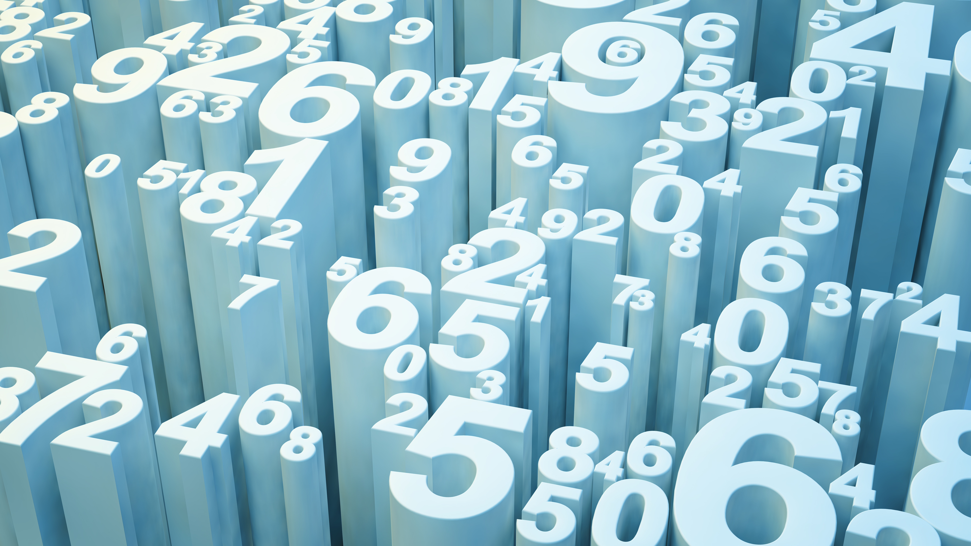
ENERGY EFFICIENCY
ELSI SAHAYA RENITA.L

Slide 2
About Data Set:
We perform energy analysis using 12 different building shapes simulated in Ecotect. The buildings differ with respect to the glazing area, the glazing area distribution, and the orientation, amongst other parameters. We simulate various settings as functions of the afore-mentioned characteristics to obtain 768 building shapes. The dataset comprises 768 samples and 8 features, aiming to predict two real valued responses.
Problem Statement:
The effect of eight input variables (relative compactness, surface area, wall area, roof area, overall height, orientation, glazing area, glazing area distribution) on two output variables, namely heating load (HL) and cooling load (CL), of residential buildings by using a statistical machine learning framework.
We have to use a number of classical and non-parametric statistical analytic tools to carefully analyze the strength of each input variable's correlation with each of the output variables in order to discover the most strongly associated input variables.
We need to estimate HL and CL, we can compare a traditional linear regression approach to a sophisticated state-of-the-art nonlinear non-parametric method, random forests.

Slide 3
TOOLS USED
        Pandas
        Numpy
        Seaborn
        Matplotlib
        SkLearn

Slide 4
APPROACHES
              Data Cleaning
              Exploratory Data Analysis (EDA)
              Correlation
              Splitting the dataset
              Machine Learning Model Building
              Feature Importance
              Selecting Best Model

Slide 5
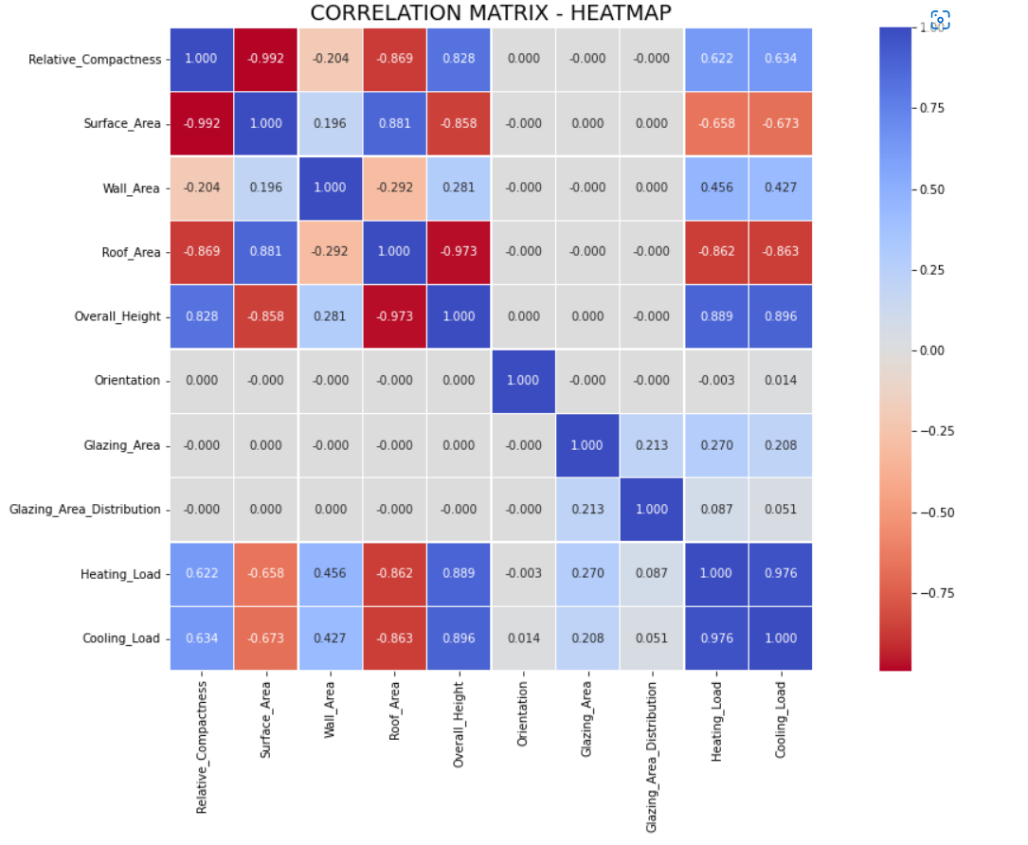
EDA INSIGHTS Feature Variables
'Orientation' and 'Overall_Height' have quite symetrical distribution.
From the Plot Relative Compactness
and Overall Height are Positively
Correlated.
Also Surface Area and Roof Area are
Negatively Correlated with Heating and
Cooling Load.
Some Attribute are Zero Correlated or
also called as Non Linear Correlation,
such as Orientation, Glazing Area and
Glazing Area Distribution.
Overall Height has the highest correlation
with both Heating Load and Cooling Load.

Slide 6
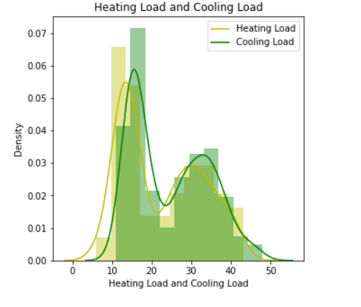
EDA INSIGHTS Target Variables
Most of the datasets are ranges between 10 to 20 for both Heating Load and Cooling Load.
Also Distribution of Heating Load and Cooling Load is Positively Skewed known as Right Skewed.

Slide 7

MACHINE LEARNING MODEL
Machine Learning Models Used to estimate Heating Load and Cooling Load are
Linear Regression
Random Forest Regressor
Decision Tree Regressor
K Nearest Neighbor Regressor
Ridge Regression
Lasso Regression

Slide 8
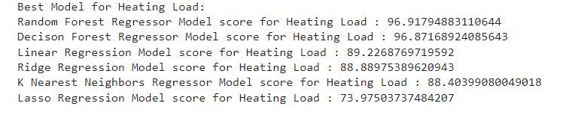
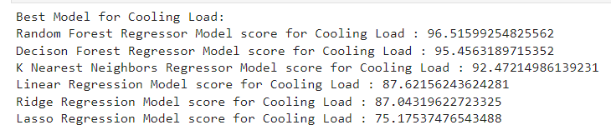
BEST MODELS BASED ON R2SCORE
HEATING LOAD
COOLING LOAD
Best Machine Learning Model for HEATING LOAD
      Random Forest Regressor (96.9% ~ 97%)
      Decision Tree Regressor (96.8%)
Best Machine Learning Model for COOLING LOAD
  Random Forest Regressor (96.4%)
  Decision Tree Regressor (95.5%)
  K Nearest Neighbor Regressor (92.4%)

Slide 9


